Slide 1
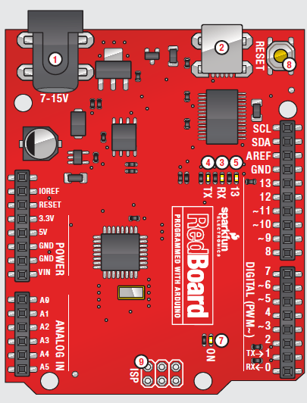
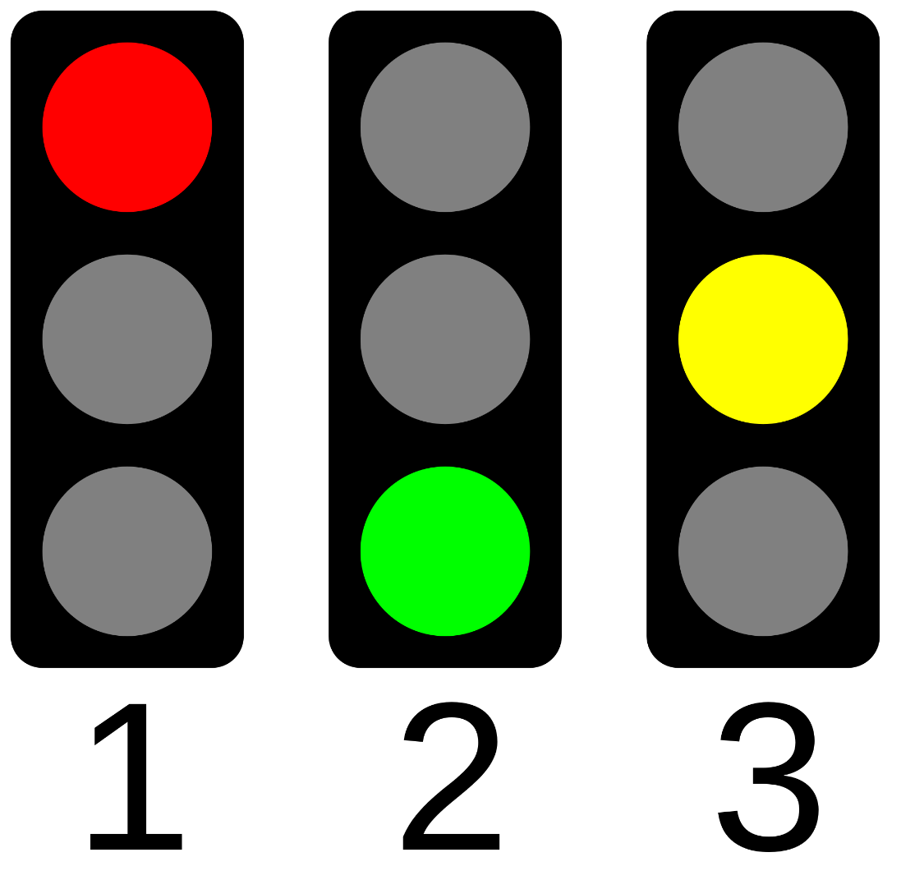

Arduino Traffic Light
Teens Engineer Birmingham
Instructors : Allaire Doussan & Mohsine Taarji

Slide 2
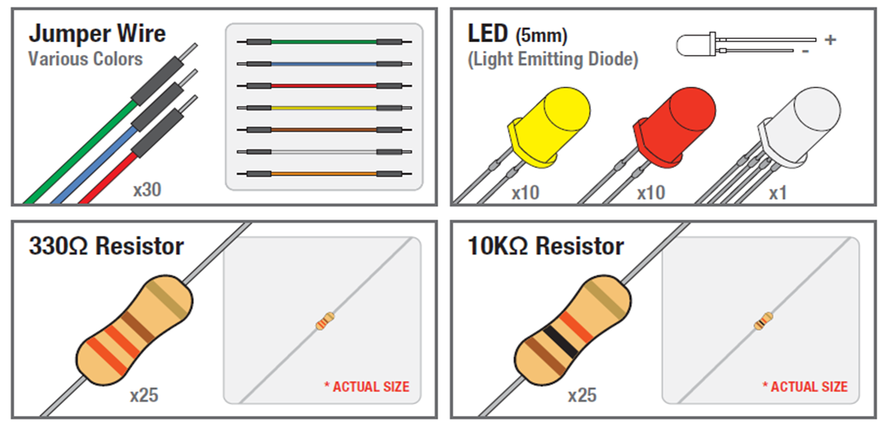
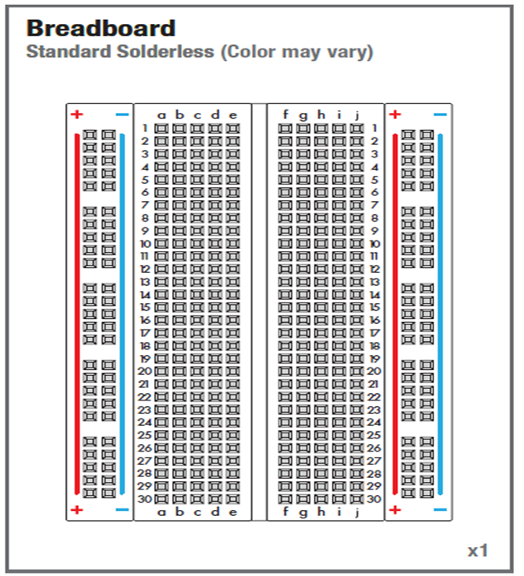
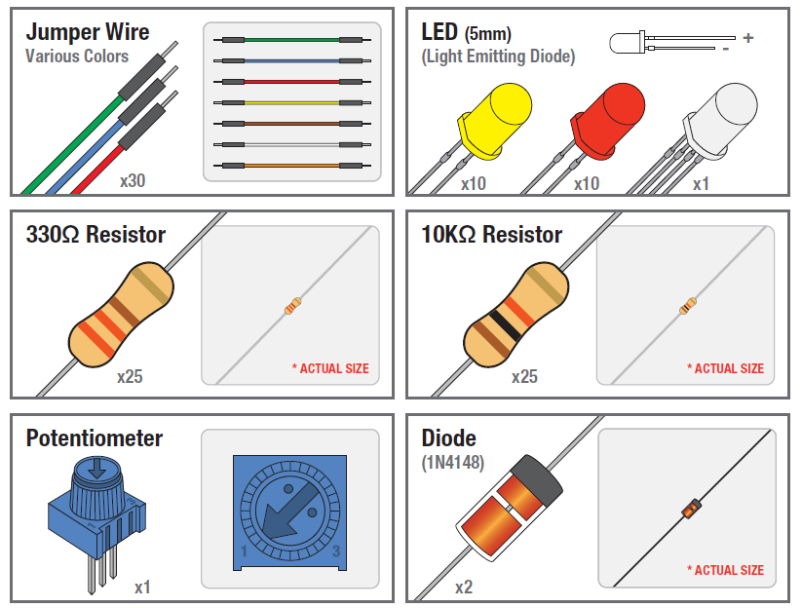
SIK Components

Slide 3
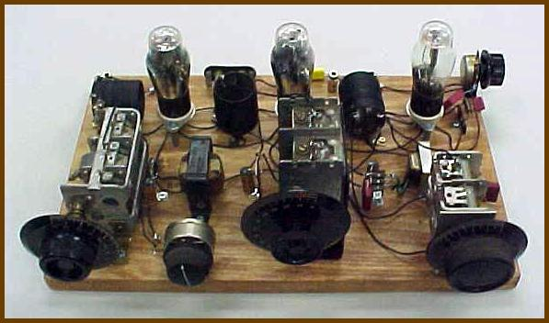
Modern Breadboard vs Old Breadboard Circuit

Slide 4
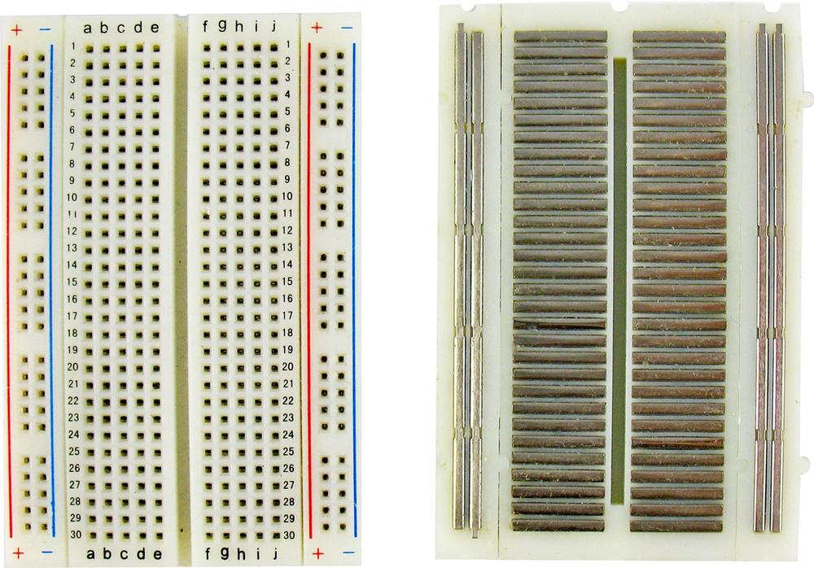
Breadboard
Front
Back

Slide 5
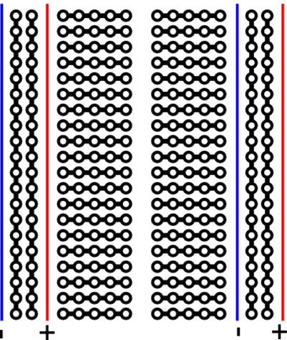
Modern Breadboard
Outside edges: pins are connected vertically
Inside rows: pins are connected horizontally with a break down the center

Slide 6
Try to connect 2 wires on the breadboard!

Slide 7
Arduino Microcontroller
USB
(to Computer)
PWR IN
RESET
A microcontroller is a physical device (HARDWARE)
POWER
5V / 3.3V / GND
Digital I\O
PWM(3, 5, 6, 9, 10, 11)
Analog INPUTS

Slide 8
Inputs and Outputs
Input: any signal going into the board.
Output: any signal exiting the board.

Slide 9
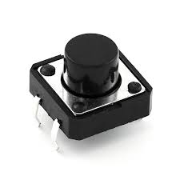
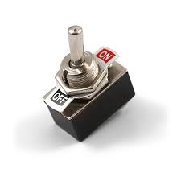
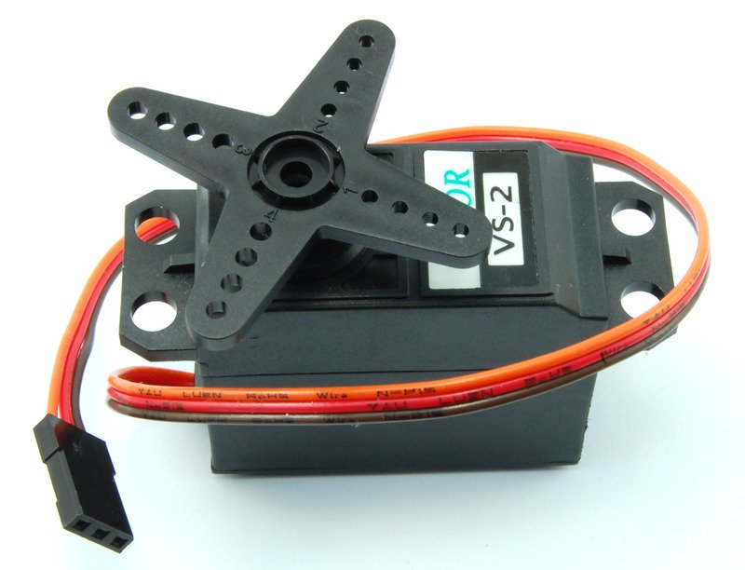
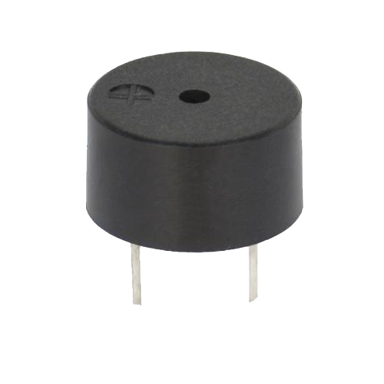
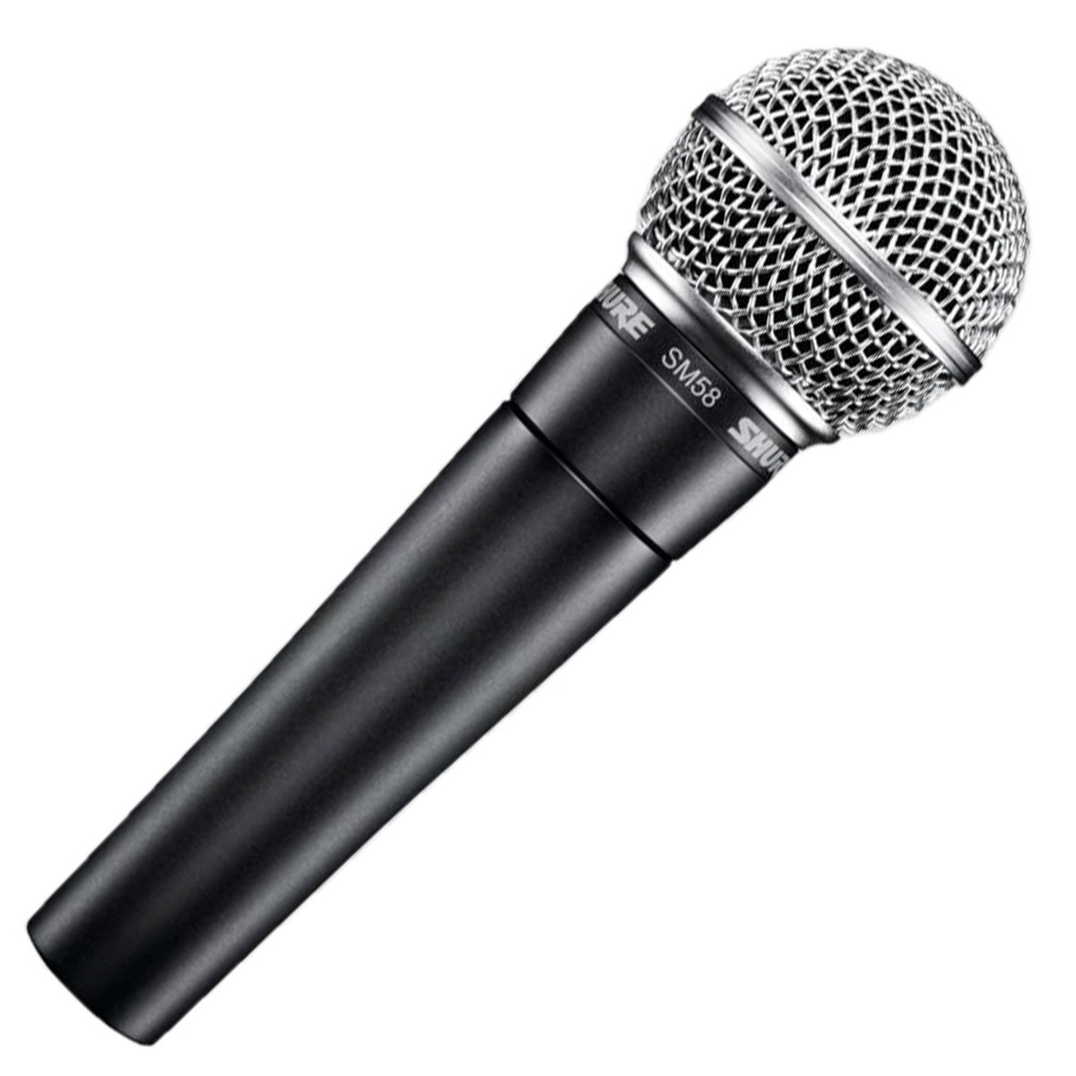
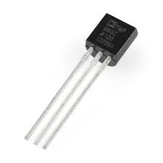
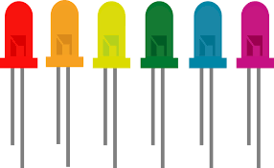
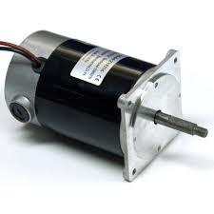
Inputs
Outputs
d
Notes:
Inputs: pushbutton, switch, infrared sensor/line follower, temperature sensor
Outputs: servo motor, piezo buzzer, LEDs, DC motor

Slide 10
Inputs
Outputs
d
Pushbutton
Switch
Servo Motor
Piezo Buzzer
Temperature Sensor
Microphone
LEDs
DC Motor
Notes:
Inputs: pushbutton, switch, infrared sensor/line follower, temperature sensor
Outputs: servo motor, piezo buzzer, LEDs, DC motor

Slide 11
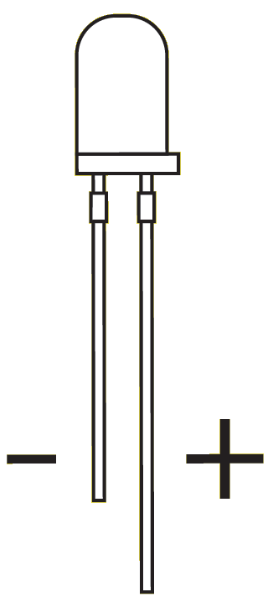
Light Emitting Diodes (LEDs)
The shorter side is negative
The longer side is positive

Slide 12
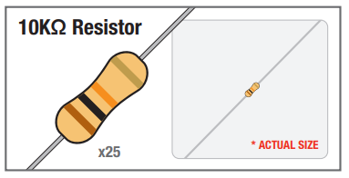
Resistors
Resistors are electrical components that resist electricity.
Resistors are used to reduce the amount of electricity in a circuit. We do this to avoid damaging certain components.
Measured in ohms or kiloohms (kohms)
Color of bands tells you how much resistance a resistor has

Slide 13
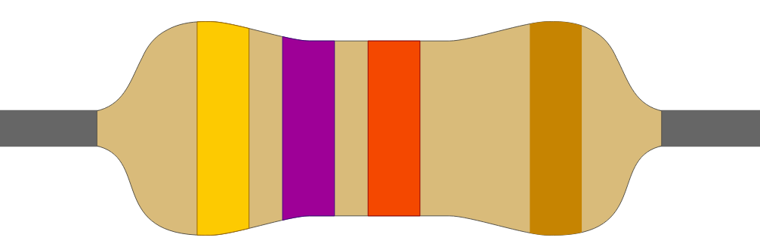
Find a resistor that looks like this one on your table

Slide 14
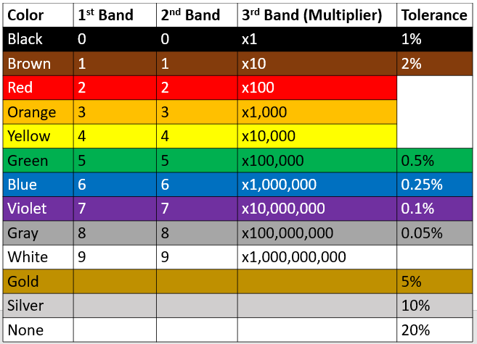
Resistor Color Code
Find the value of this resistor

Slide 15
Resistor Color Code
Orange | Orange | Brown | Gold

Slide 16
Resistor Color Code
Orange | Orange | Brown | Gold
3

Slide 17
Resistor Color Code
Orange | Orange | Brown | Gold
3 | 3

Slide 18
Resistor Color Code
Orange | Orange | Brown | Gold
3 | 3 | x10

Slide 19
Resistor Color Code
Orange | Orange | Brown | Gold
3 | 3 | x10 | 5% tolerance

Slide 20
Resistor Color Code
Orange | Orange | Brown | Gold
3 | 3 | x10 | 5% tolerance
33 x 10
330 ohm or 330 ohm resistor

Slide 21
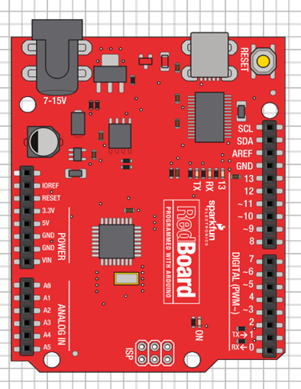


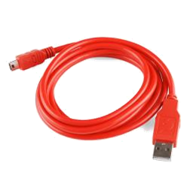
Make sure your board is unplugged!

Slide 22
Testing the LED with a constant power supply

Slide 23
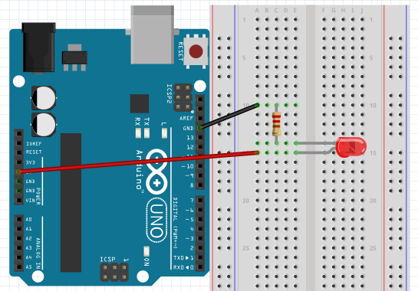
LED Circuit
1
5
Negative Side
GND
10
15
5V
Positive Side
20
25

Slide 24
Programming the LED to blink using a Digital Input/Output (DIO) pin

Slide 25
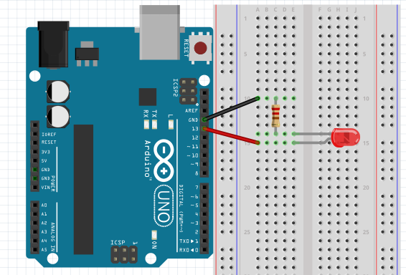
Change the Power Source From 5V to Pin 13
Negative Side
GND
Change 5V to Pin 13
Positive Side

Slide 26
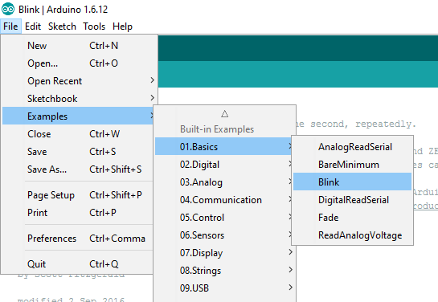

Open Blink example in Arduino

Slide 27
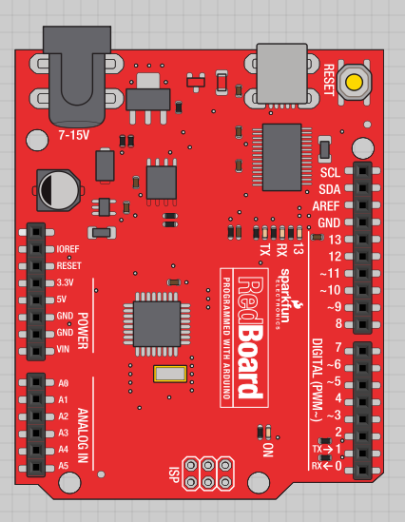
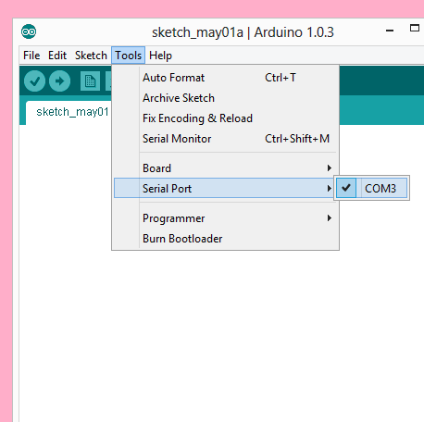
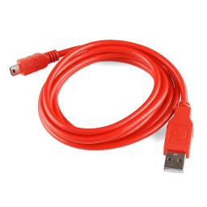
Plug in your board and select the serial port

Slide 28
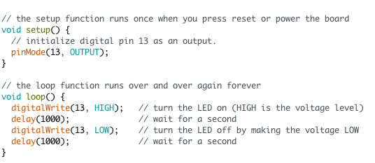
Blink
*read comments for hints*

Slide 29
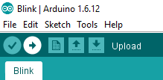
Upload your code to the board
Click here to upload

Slide 30
How do traffic lights work?

Slide 31
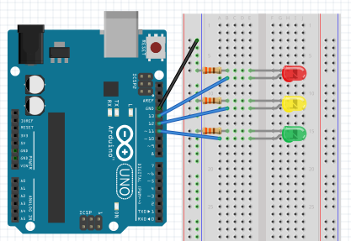
Single Traffic Light Circuit
Negative Side
Positive Side

Slide 32
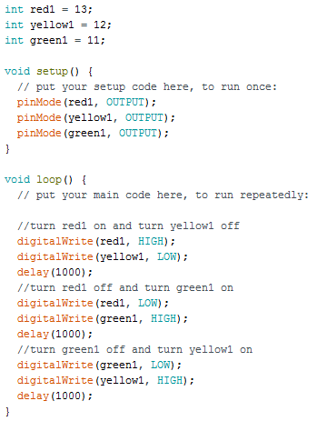
Single Traffic Light Code (1/2)
Variables for LED pin #’s
Configures LED pin to be an OUTPUT

Slide 33
Single Traffic Light Code (2/2)
Program that runs
LEDs are turned on and off like a traffic light
HIGH = LED ON
LOW = LED OFF

Slide 34
Upload your code to the board
Click here to upload

Slide 35
How do intersections work?
Light One
Light Two
red1
red2
Light Two stays red while Light One goes from green to yellow to red.
Light One stays red while Light Two goes from green to yellow to red
yellow1
yellow2
green1
green1

Slide 36
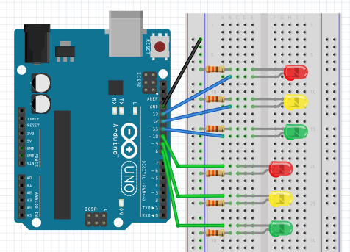
Traffic Light Intersection Circuit
Negative Side
Positive Side

Slide 37
Traffic Light Intersection Pseudo Code
red1 HIGH
red2 HIGH
red2 LOW
green2 HIGH
delay
delay
red1 LOW
green1 HIGH
green2 LOW
yellow2 HIGH
delay
delay
green1 LOW
yellow1 HIGH
yellow2 LOW
red2 HIGH
delay
delay
yellow1 LOW
red1 HIGH
Loops back to beginning
delay

Slide 38
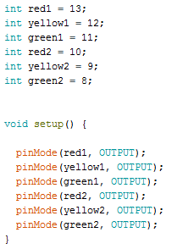
Traffic Light Intersection Code
Variables for LED pin #’s
Configures LED pin to be an OUTPUT

Slide 39
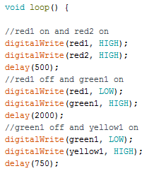
Traffic Light Intersection Code
Program that runs
LEDs are turned on and off like a traffic light
HIGH = LED ON
LOW = LED OFF

Slide 40
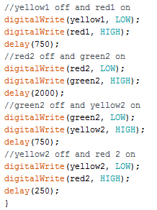
Traffic Light Intersection Code
Program that runs
LEDs are turned on and off like a traffic light
HIGH = LED ON
LOW = LED OFF

Slide 41
Upload your code to the board
Click here to upload

Slide 42
Questions?
Thank you!

Slide 43
Arduino Reference Links
void
setup
pinMode
loop
digitalWrite
delay

